Slide 1
BIGDATA
Presented by
vasudharini

Slide 2
BIGDATA
Extremely large data sets
Complex data
Managing and analyzing data
Data are stored in TB or PB

Slide 3
CHARACTERISTICS OF BIG DATA
VOLUME- DATA IN REST
VELOCITY- DATA IN MOTION
VALUE - SPECTRUM MODELING PREDICTION
VARIETY- DIFFERENT DATA LIKE STRUCTURED, SEMI STRUCTURED, UN STRUCTURED
VERACITY- DATA UNCERTAINITY AND SECURITY
VIABILTY - VARIABLE SELECTION RELEVANCE

Slide 4
TYPES OF BIGDATA
STRUCTURED DATA - rows and coloumbs ,tables
SEMISTRUCTURED DATA- xml files
UNSTRUCTURED DATA- audio,text,document.

Slide 5
HADOOP
HADOOP IS AN OPEN SOURCE JAVA FRAMEWORK that SUPPORTS THE PROCESSING AND STORING OF EXTREMLY LARGE DATASETS IN A DISTIRUBED COMPUTING ENVIRONMENT

Slide 6
ARCHITECTURE OF HADOOP
ARCHITECTURE OF HADOOP 1.X
ARCHITECTURE OF HADOOP 2.X

Slide 7
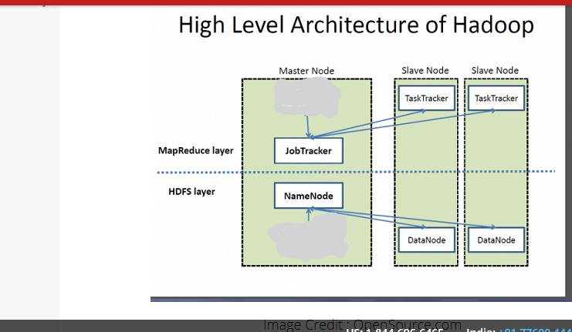
ARCHITECTURE

Slide 8
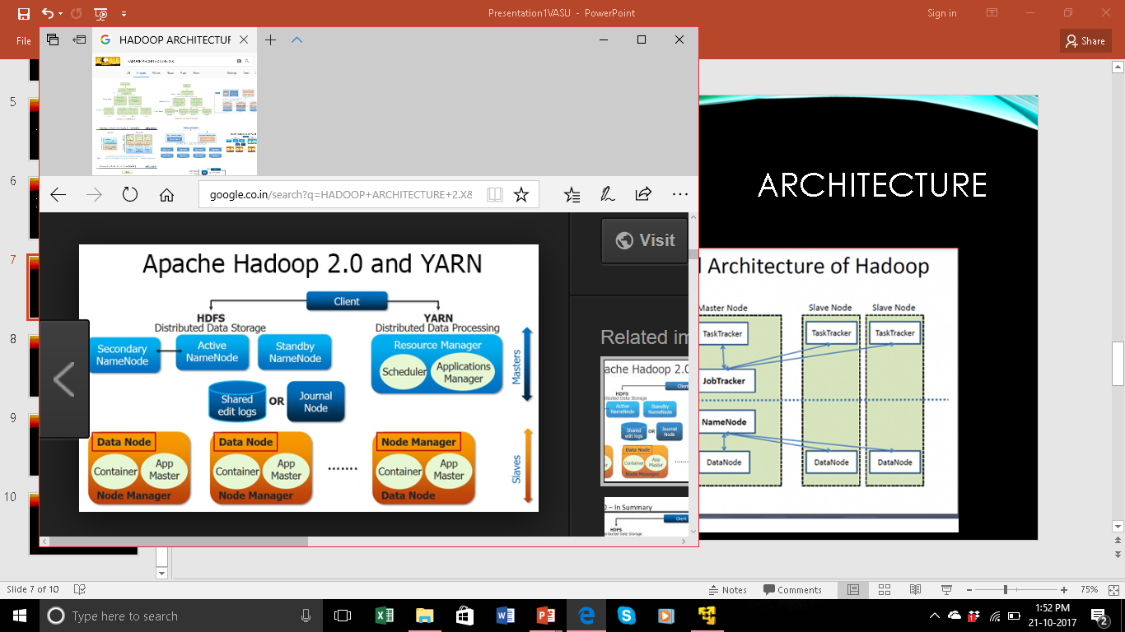
Architecture 2.x

Slide 9
limitations
HADOOP 2.X resolve most of the Hadoop 1.x limitations by using new architecture.
By decoupling map reduce component responsibilities into different component..
By introducing yarn component for resource management
By decoupling component responsibilities.it supports multiple namespace, multiple tendency, high availability.

Slide 10
Yarn benefits
HADOOP 2.X YARN HAVE FOLLOWING BENEFITS:
HIGH SCALABILTY
HIGH AVAILABILITY
SUPPORTS MULTIPLE PROGRAMMING MODELS
SUPPORTS MULTI_TENDENCY
SUPPORTS MULTIPLE NAMESPACES
IMPROVED CLUSTER UTILIZATION
SUPPORTS HORIZONTAL SCALABILITY

Slide 11
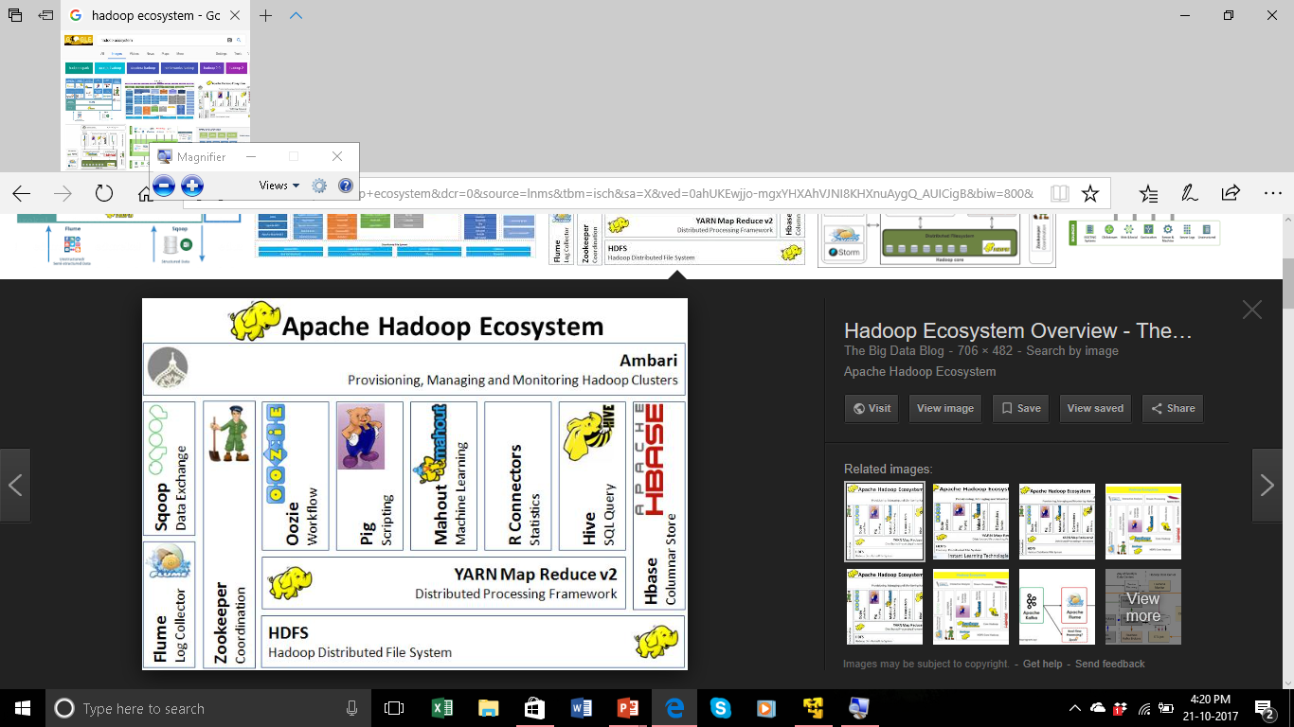
HADOOP ECOSYSTEM

Slide 12
TOOLS USED FOR PROCESSING
MAP REDUCE
Hive
pig

Slide 13
MAP REDUCE
It is used for processing data.
It has three phases such as
Map
Sort and shuffle
reduce

Slide 14
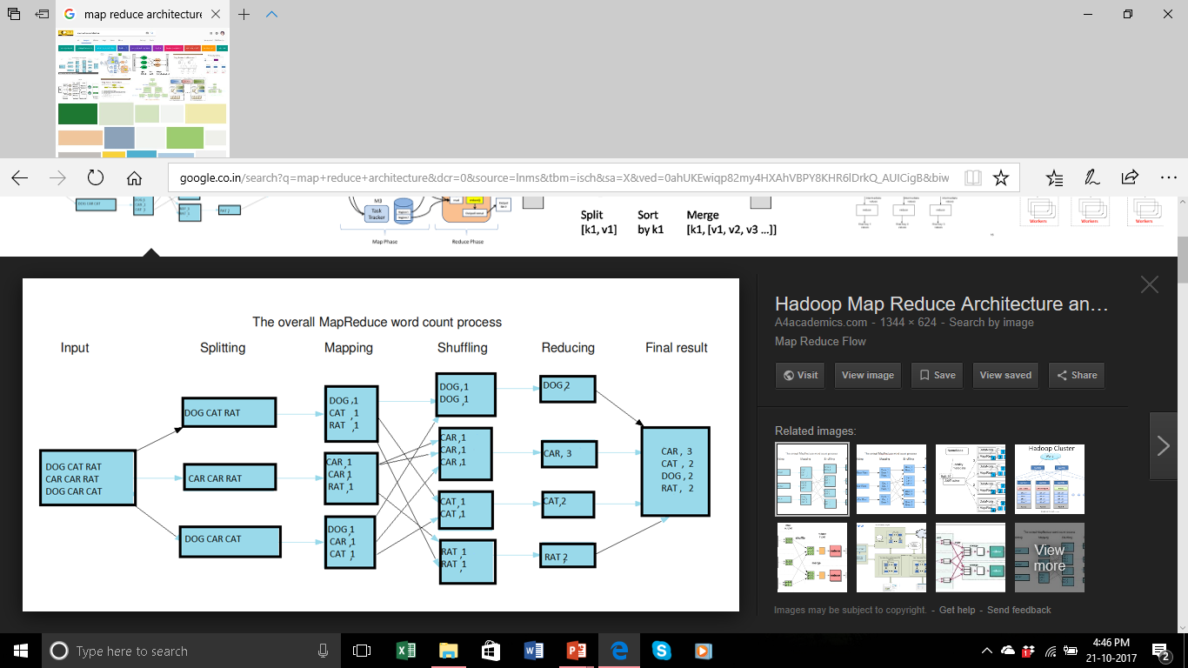
Map reduce architecture

Slide 15
hive
Hive is a data ware house software projects built on top of apache Hadoop for providing data summerization, query and analysis.
It is tool to process structured data.
It can process mapreduce by using hive and it uses hive query language.
It has two tables:- managed table,external table.

Slide 16
pig
It is scripting language
Pig can have structured , unstructured and semi structured data.
It can work in complex data.
Pig can be done in any language it is also used efficiently in processing mapreduce.

Slide 17
THANKYOU

